Slide 1
Time Management & Boolean Arithmetic
Time Management, Overview of Numbers in Binary, Boolean Arithmetic, Circuits for Adding Binary Numbers

Slide 2
Project 2 Check-in
How has Project 2 been coming along?
What questions do you have about Project 2?
Remember to double check your submission on GitLab
  Navigate to GitLab, open tags, and verify that the associated commit includes your expected changes

Slide 3
Lecture Outline
Time Management
  Identifying Weekly Time Commitments
Overview of Numbers in Binary
  Comparison Between Binary and Decimal
Boolean Arithmetic
  Addition Operator and Handling Binary Overflow
Circuits for Adding Binary Numbers
  Overview of the Half Adder and Full Adder

Slide 4
Time Management
One of your most valuable resources in college is time
What typically fills up your time during the quarter?
  Lectures, quiz sections, and attending office hours
  Part-time jobs and working
  Studying
  Extracurricular activities or RSOs
  Commuting
  Chores at home
  Socializing with friends and family
  Physical, mental, spiritual activities

Slide 5
Weekly Time Commitments
Class meeting times and quiz sections
Family, friends, community, extracurricular commitments
Physical, mental, social, spiritual activities
Studying for each of your classes
  The number of credits for a course reflects the number of hours the class meets
  In general, courses require two hours of homework for every one hour of class
What else is not reflected given your specific situation?

Slide 6
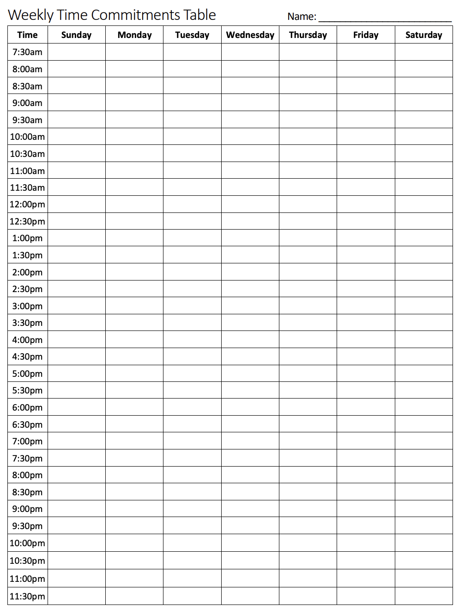
Tracking Weekly Time Commitments
We often don’t realize what takes up our time until we manually track how we use our time
Exercise: Complete the weekly time commitments table
Tip: Use different colors for different activity types

Slide 7
Time Management Group Discussion
Now that you’ve filled out your weekly time commitments, discuss the following in groups for 4-6 minutes:
Does anything surprise you about the way you spend your time?
What might you change about the way you utilize your time?
How could you use this time commitments sheet in the future?

Slide 8
Lecture Outline
Time Management
  Identifying Weekly Time Commitments
Overview of Numbers in Binary
  Comparison Between Binary and Decimal
Boolean Arithmetic
  Addition Operator and Handling Binary Overflow
Circuits for Adding Binary Numbers
  Overview of the Half Adder and Full Adder

Slide 9
What is Binary?
A base n number system is a system of number representation with n symbols
Decimal system is a base 10 number system
  Base 10 symbols: 0, 1, 2, 3, 4, 5, 6, 7, 8, 9 (each called a digit)
  Increase a number by moving to the next greatest symbol
  Add another digit when we run out of symbols
Binary is a base 2 number system
  Base 2 symbols: 0, 1 (each called a bit)
  Often prefixed with 0b (e.g., 0b1101, 0b10)
  Least-significant bit (LSB): Lowest-order position of a binary value
  Most-significant bit (MSB): Highest-order position of a binary value

Slide 10
Representing Numbers in Base 2
Binary numbers are identical, except in base 2
  Describe a value by specifying multiples of powers of 2
  For example, a breakdown of 0b1101 in binary (13 in decimal)
Binary | Power of 2
0b1000 | 1 × 2³
0b0100 | 1 × 2²
0b0000 | 0 × 2¹
0b0001 | 1 × 2⁰

Slide 11
Binary vs. Decimal
Binary | Decimal
0b000 | 0
0b001 | 1
0b010 | 2
0b011 | 3
0b100 | 4
0b101 | 5
0b110 | 6
0b111 | 7
... | ...

Slide 12
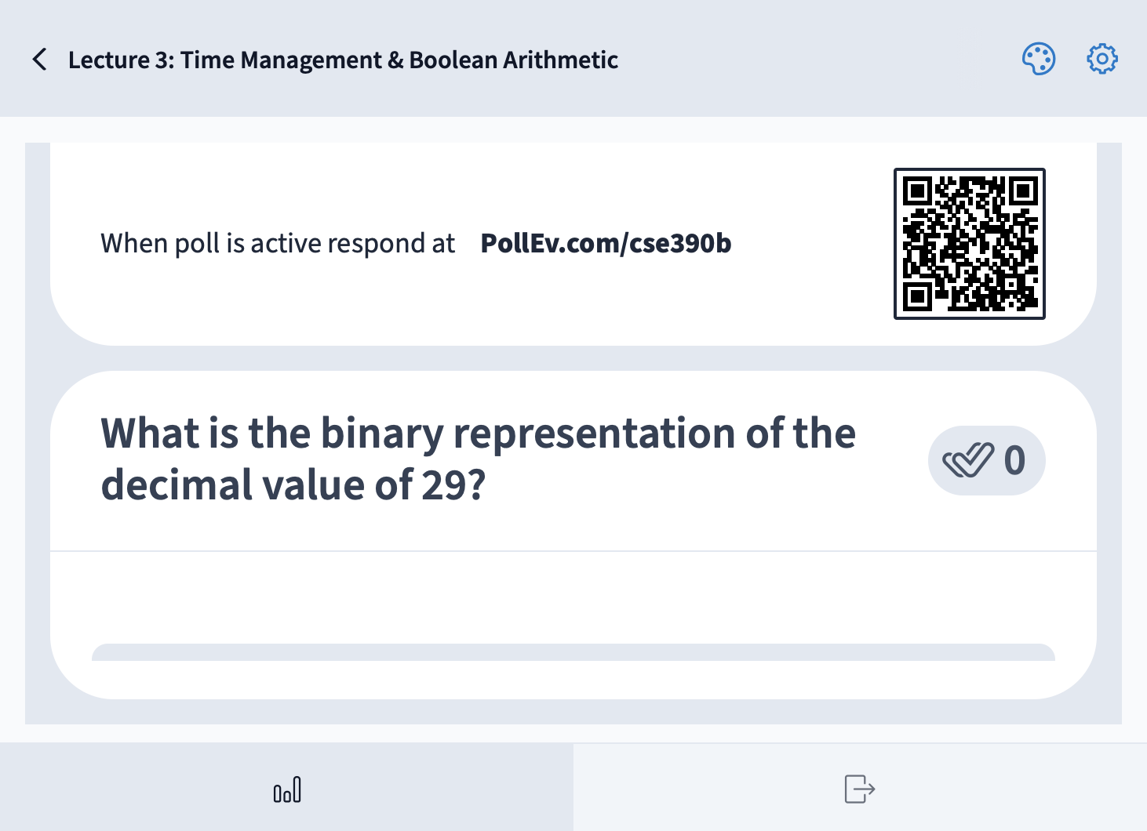
What is the binary representation of the decimal value 29?
0b011011
0b011101
0b100011
0b100111
We’re lost…

Slide 13
Lecture Outline
Time Management
  Identifying Weekly Time Commitments
Overview of Numbers in Binary
  Comparison Between Binary and Decimal
Boolean Arithmetic
  Addition Operator and Handling Binary Overflow
Circuits for Adding Binary Numbers
  Overview of the Half Adder and Full Adder

Slide 14
Roadmap: Boolean Arithmetic
Addition
Subtraction
Comparison (<, >, ==, !=)
Multiplication
Division
Implement
Get it for free!
Get it for free!
Postpone to software
Postpone to software

Slide 15
Binary Addition
How do we add two binary numbers?
  As humans, we could convert to decimal and then back
Example: 0b101 + 0b010
  First convert 0b101 to decimal (result is 5)
  Next convert 0b010 to decimal (result is 2)
  Add the decimal numbers and convert back to binary
    5 + 2 = 7, which is 0b111 in binary
What’s more useful is understanding the rules of binary addition so we can teach them to a computer

Slide 16
Case Study: Decimal Addition
Consider how we perform decimal addition
  Right to left (least significant place to most significant place)
  When a column’s result is more than one digit, carry over the digit that overflows
Example:
carry
a | 5 | 7 | 8 | 3
b | 2 | 4 | 5 | 6
sum

Slide 17
Binary Addition
Binary addition conceptually the same as decimal addition
  Right to left (least significant place to most significant place)
  When a column’s result is more than one digit, carry over the bit that overflows
Example:
carry
a | 0 | 1 | 1 | 1
b | 0 | 1 | 0 | 1
sum

Slide 18
Binary Overflow
What if there’s a carry bit in the last column?
Example:
carry
a | 0 | 1 | 1 | 0
b | 1 | 0 | 1 | 0
sum

Slide 19
Binary Overflow
What if there’s a carry bit in the last column?
We can’t represent it in our fixed-width numbers
  We are going to “drop” or ignore the extra carry bit
carry
a |  | 0 | 1 | 1 | 0
b |  | 1 | 0 | 1 | 0
sum

Slide 20
Lecture Outline
Time Management
  Identifying Weekly Time Commitments
Overview of Numbers in Binary
  Comparison Between Binary and Decimal
Boolean Arithmetic
  Addition Operator and Handling Binary Overflow
Circuits for Adding Binary Numbers
  Overview of the Half Adder and Full Adder

Slide 21
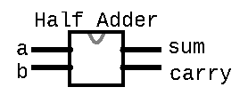
Half Adder
Circuit for adding two bits together
Takes in two inputs: a, b
  a is the first bit being added
  b is the corresponding bit to be added
carry
a | 0 | 1 | 1 | 0
b | 1 | 0 | 1 | 0
sum
Produces two outputs: sum, carry
  sum is the value to be put for this column in the result
  carry is the value to be carried over to the next column
/**
* Computes the sum of 2 bits
*/
CHIP HalfAdder {
  IN a, b;
  OUT sum, carry;
  PARTS:
  // Put your code here:
  }

Slide 22
Half Adder Example
Example: 0b0111 + 0b0101
For the right-most (least significant) column:
  a = 1
  b = 1
  sum =
  carry =
carry
a | 0 | 1 | 1 | 1
b | 0 | 1 | 0 | 1
sum

Slide 23
Half Adder Example
Boolean expressions:
  sum =
  carry =
a | b | sum | carry
0 | 0
0 | 1
1 | 0
1 | 1

Slide 24
Half Adder Group Work
Determine the half adder logical Boolean expression
  First, fill in the truth table values for sum and carry based on the inputs
  Then, develop a Boolean expression for sum and carry based on the truth table
Five-minute group discussion, identify one person to share each of the following as a large group:
  Overview of what the half adder does
  Thought process for reaching the Boolean expression for sum
  Thought process for reaching the Boolean expression for carry

Slide 25
Half Adder Example
Boolean expressions:
  sum = a XOR b
  carry = a AND b
a | b | sum | carry
0 | 0 | 0 | 0
0 | 1 | 1 | 0
1 | 0 | 1 | 0
1 | 1 | 0 | 1

Slide 26
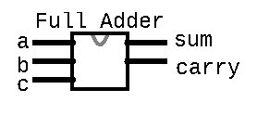
Full Adder
Circuit for adding three bits together (two bits and carry bit together from previous column)
  a is the first bit being added
  b is the corresponding bit to be added
  c is the carry bit from the right column
carry
a | 0 | 1 | 1 | 0
b | 1 | 0 | 1 | 0
sum
Produces two outputs: sum, carry
  sum is the value to be put for this column in the result
  carry is the value to be carried over to the next column
/**
* Computes the sum of 3 bits
*/
CHIP FullAdder {
  IN a, b, c;
  OUT sum, carry;
  PARTS:
  // Put your code here:
  }

Slide 27
Full Adder
Example: 0b0111 + 0b0101
For the second (second least significant) column:
  a = 1
  b = 0
  c = 1
  sum =
  carry =
carry |  |  | 1
a | 0 | 1 | 1 | 1
b | 0 | 1 | 0 | 1
sum |  |  |  | 0

Slide 28
Full Adder Truth Table
a | b | c | sum | carry
0 | 0 | 0
0 | 0 | 1
0 | 1 | 0
0 | 1 | 1
1 | 0 | 0
1 | 0 | 1
1 | 1 | 0
1 | 1 | 1

Slide 29
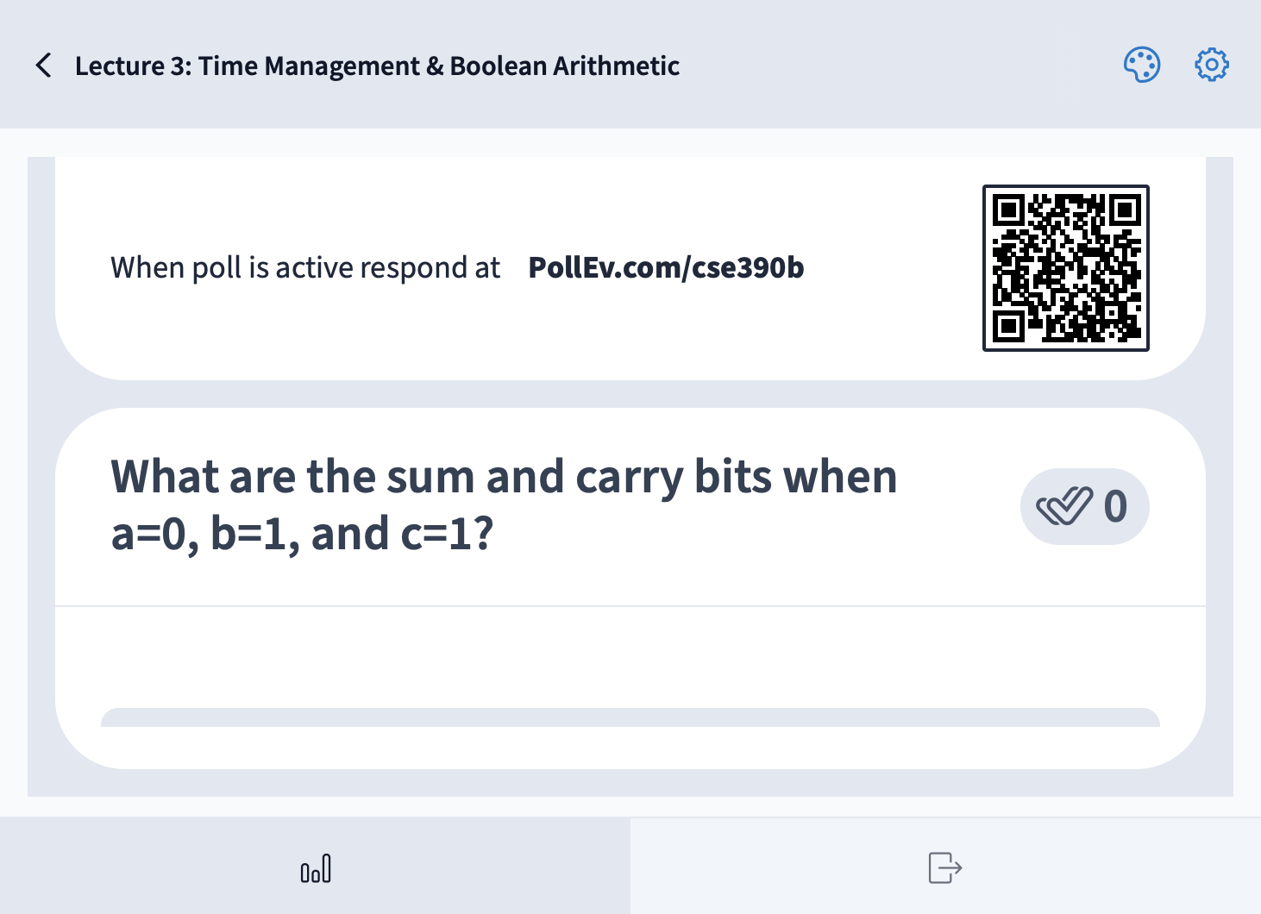
What are the sum and carry bits when a=0, b=1, and c=1?
a | b | c | sum | carry
0 | 0 | 0
0 | 0 | 1
0 | 1 | 0
0 | 1 | 1 | 0 | 1
1 | 0 | 0
1 | 0 | 1
1 | 1 | 0
1 | 1 | 1
sum = 0, carry = 0
sum = 0, carry = 1
sum = 1, carry = 0
sum = 1, carry = 1
We’re lost…

Slide 30
Full Adder Truth Table
a | b | c | sum | carry
0 | 0 | 0 | 0 | 0
0 | 0 | 1 | 1 | 0
0 | 1 | 0 | 1 | 0
0 | 1 | 1 | 0 | 1
1 | 0 | 0 | 1 | 0
1 | 0 | 1 | 0 | 1
1 | 1 | 0 | 0 | 1
1 | 1 | 1 | 1 | 1

Slide 31
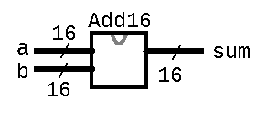
Multi-Bit Adder
Adds two 16-bit numbers
Connects the full adders for each column together (wires the out carry from one column to the in carry of the next)
/**
* Adds two 16-bit Two’s Complement
* values. Overflow is ignored.
*/
CHIP Add16 {
  IN a[16], b[16];
  OUT sum[16];
  PARTS:
  // Put your code here:
  }
… 0 1 1 1 0 0
… 0 0 1 0 1 0 1
… 1 0 1 1 1 0 0
+
… 1 1 1 0 0 0 1

Slide 32
Lecture 3 Reminders
Project 2 due Friday (1/12) at 11:59pm
Course Staff Support
  Amy has office hours tomorrow in CSE2 151 at 1:30pm
  Feel free to post your questions on the Ed discussion board too

